Slide 1
Capstone Project Exploratory Data Analysis Hotel Booking Analysis
Aishwarya Kande

Slide 2
Contents
Introduction
Data exploration
Data cleaning
Types of hotel
Cancellation rate
Deposit policies
Bookings
Customer segmentation
Preferences
Meals
Room Type
car parking
Guests from different countries
ADR and Corelation Heat map
Conclusion
References

Slide 3
Work Flow
So we will divide our work flow into following 3 steps.
Data Collection and Understanding
Data Cleaning and Manipulation
Exploratory Data Analysis(EDA)
EDA will be divided into following 3 analysis.
Univariate analysis: Univariate analysis is the simplest of the three analyses where the data you are analyzing is only one variable.
Bivariate analysis: Bivariate analysis is where you are comparing two variables to study their relationships.
Multivariate anlysis: Multivariate analysis is similar to Bivariate analysis but you are comparing more than two variables.

Slide 4
Data Collection and Understanding
After collecting data it’s very important to understand your data. So we had hotel Booking analysis data. Which had 119390 rows and 32 columns. So let’s understand this 32 columns.
Data Description:
hotel :Resort Hotel or City Hotel
is_canceled : Value indicating if the booking was canceled (1) or not (0)
lead_time : Number of days that elapsed between the entering date of the booking and the arrival date
arrival_date_year : Year of arrival date
arrival_date_month : Month of arrival date
arrival_date_week_number : Week number of year for arrival date
arrival_date_day_of_month : Day of arrival date
stays_in_weekend_nights : Number of weekend nights
stays_in_week_nights : Number of week nights.
adults : Number of adults
children : Number of children
babies : Number of babies
meal : Type of meal booked.
country : Country of origin.

Slide 5
market_segment : Market segment designation. (TA/TO)
distribution_channel : Booking distribution channel.(T/A/TO)
is_repeated_guest : is a repeated guest (1) or not (0)
previous_cancellations : Number of previous bookings that were cancelled by the customer prior to the current booking
previous_bookings_not_canceled : Number of previous bookings not cancelled by the customer prior to the current booking
reserved_room_type : Code of room type reserved.
assigned_room_type : Code for the type of room assigned to the booking.
booking_changes : Number of changes made to the booking from the moment the booking was entered on the
PMS until the moment of check-in or cancellation
deposit_type : No Deposit, Non Refund , Refundable.
agent : ID of the travel agency that made the booking
company : ID of the company/entity that made the booking .
days_in_waiting_list : Number of days the booking was in the waiting list before it was confirmed to the customer
customer_type : type of customer. Contract,Group,transient,Transient party.
adr : Average Daily Rate as defined by dividing the sum of all lodging transactions by the total number of staying nights
required_car_parking_spaces : Number of car parking spaces required by the customer
total_of_special_requests : Number of special requests made by the customer (e.g. twin bed or high floor)
reservation_status : Reservation last status.

Slide 6

Hotel Industry
A few decades ago, traveling was not a part of everyday life. But today travel is an enormous budding industry of 8.8 trillion economy. This directly affects the hotel industry which is highly competitive..
We are here with a compact data to study about the hotel industry, mainly the booking. We are focusing on two types of hotels in this study i.e. City Hotels, Resort Hotels
Overall, sales from hotel accounts 87.4% of industry revenue (in India 53.9% and 8% total employment rate).

Slide 7
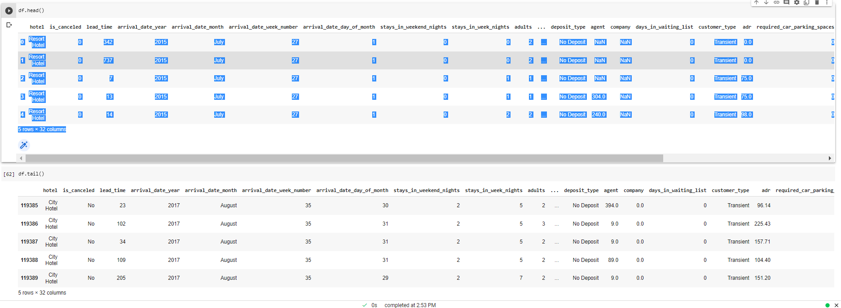
Exploring the Dataset

Slide 8
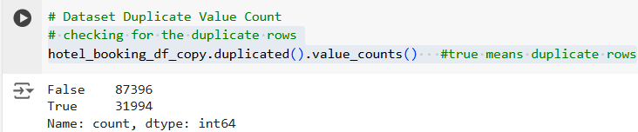
Checking and replacing the Duplicate Values
Handling Duplicates : Data has 31994 duplicate values.
We have handled this duplicate data with drop duplicate method. So we will have clean data.

Slide 9
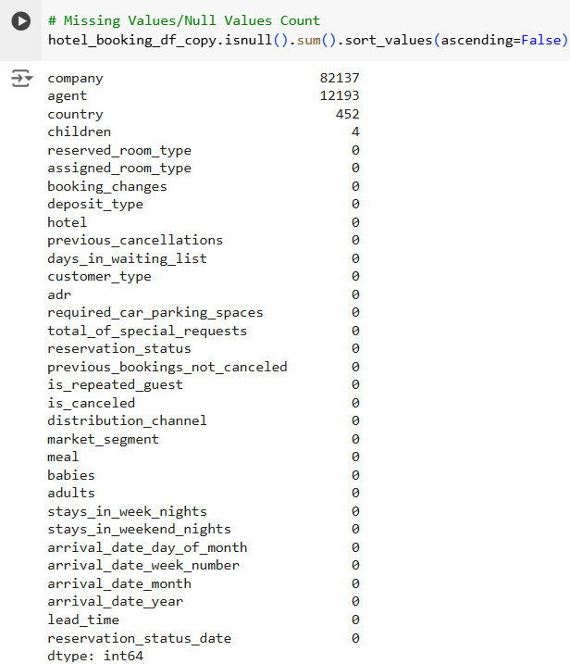
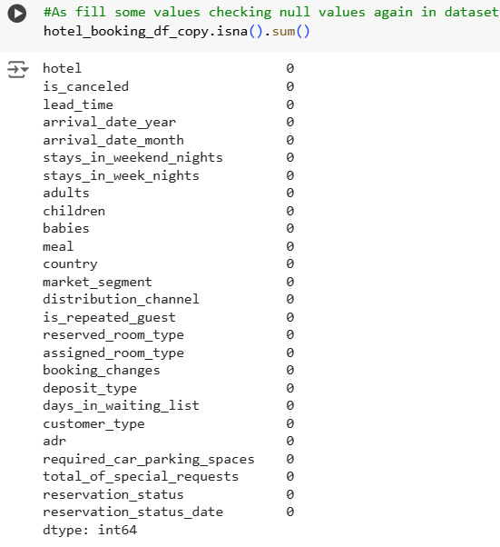
Checking and replacing the Null Values

Slide 10
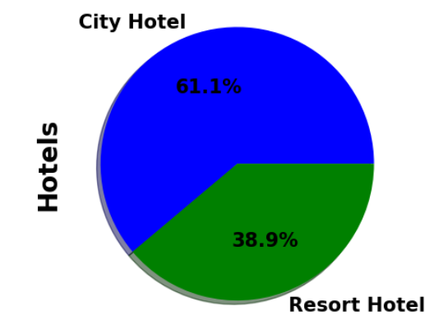
City Hotel and Resort Hotel
It is Observed that City Hotel has more number of bookings compared to Resort Hotel.
The obvious assumption for this trend would be because of monetary reasons.
City hotels would be more affordable than resort hotels due to accessibility, reliability and lavishing factors.

Slide 11
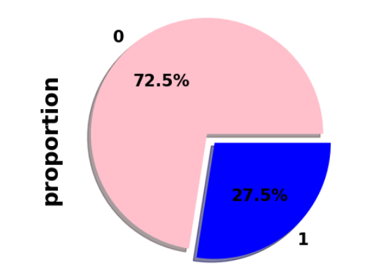
Cancelled Bookings
It is Observed that out of 87,396 bookings made, 63371 of them have checked in and 24025 of them has cancelled their bookings.
In percentage, it is about 72.5% of check-in bookings and 27.5% of bookings were cancelled.
High cancellation rate will adversely affect the hotel industry which reduces the yield of profit.

Slide 12
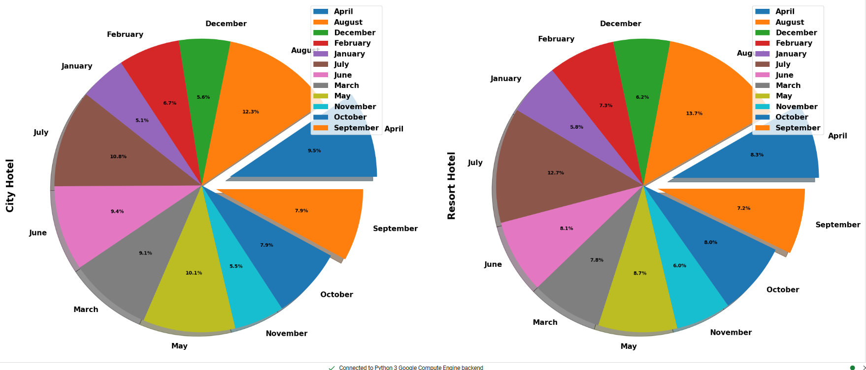
Most Preferred Month for Booking
From the above graph we can see in city hotels booking is high in August and low in January.
In resort hotels booking is high in July and August, so people usually book hotel 30-60 days in advance.

Slide 13
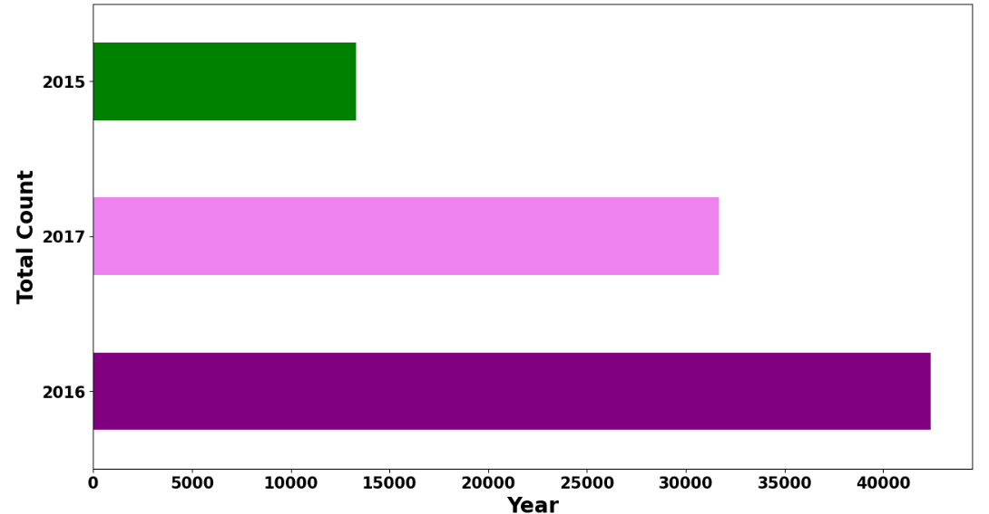
Number of Bookings Across Different Years
Most Number of the bookings are done in the year 2016 following 2017 and 2015 for the dataset given comprising the data for these 3 years.
When, sub plotted, we can see that City hotel has high demand rather than Resort hotels due to its reliability and price difference compared to resort hotels.

Slide 14
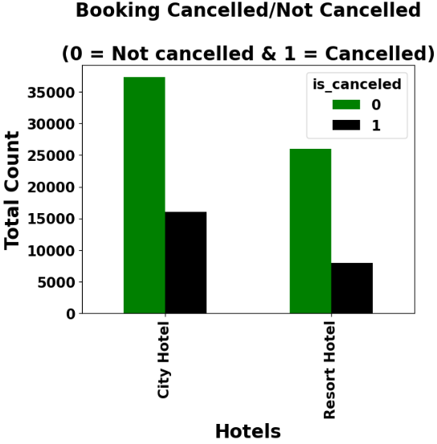
Cancellation status with Hotel Type
we have found that city hotels have high ratio of not cancelled booking than resort hotels.

Slide 15
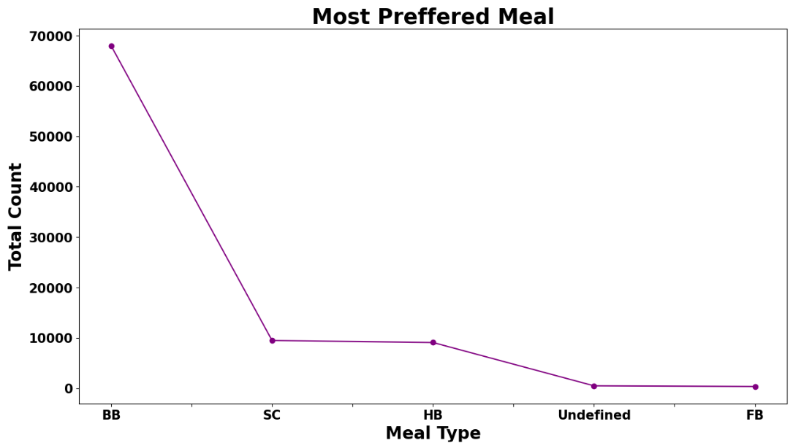
Meals Preference
As per the above Graph, we can conclude that guests for BB (i.e. Bed & Breakfast) is more than others i.e. Half Board(HB), Full Board(FB), Self Catering(SC)

Slide 16
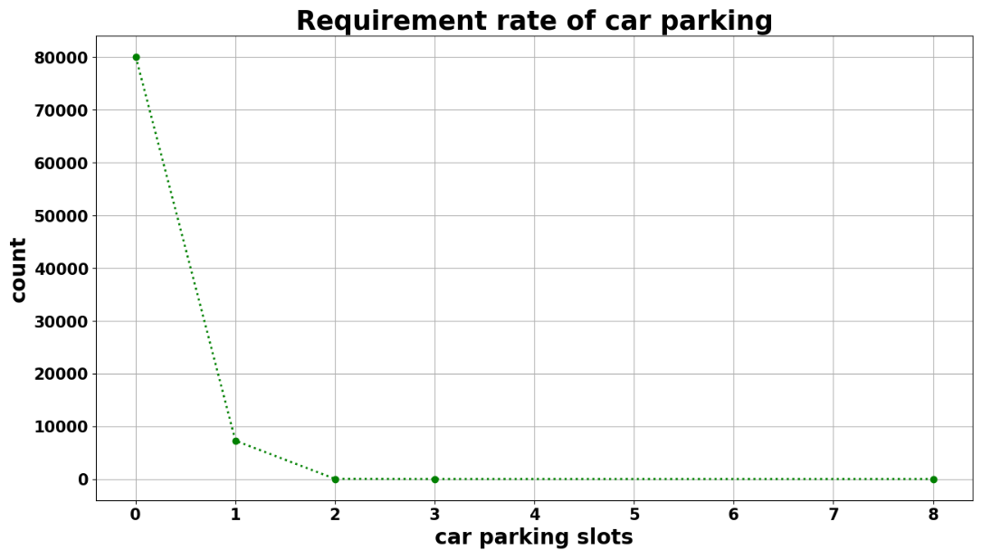
Car Parking Space Analysis
Most of the hotels have zero car space parking.
Among which have car space parking has one car spacing and the trend decreases drastically as number of car spacing increases.

Slide 17

Top 10 Countries with highest number of Bookings
After analyzing the dataset, we found that Portugal tops the position with 48590 customers followed by UK with 12129, France with 10415, Spain with 8568 and Germany with 7287 customers.
Netherlands sits back with least number of customers among the top 10Countries.

Slide 18
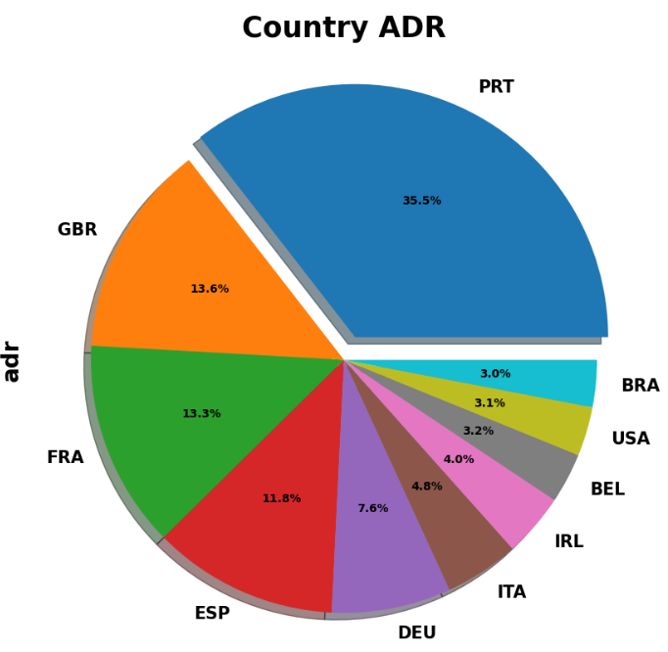
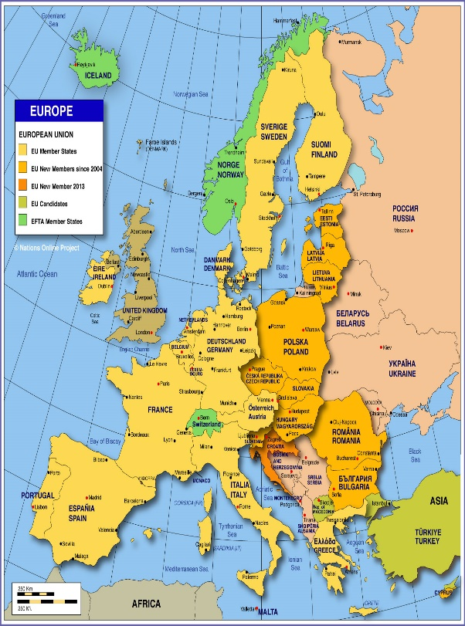
Top 10 Countries with highest ADR

Slide 19
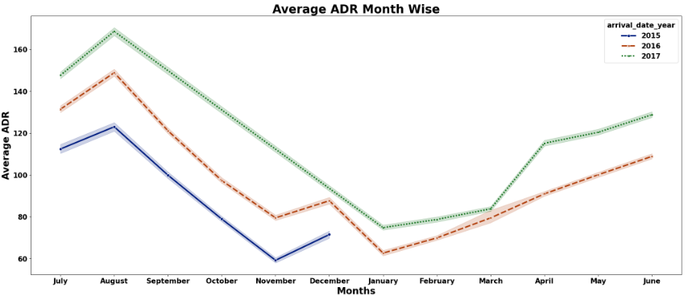
Average ADR Month and Year Wise
In 2015 highest ADR is in august month which is 122 and lowest ADR is in November month. For 2016 , highest ADR is in august month which is 148 and lowest ADR is in January month. For 2017 , highest ADR is in august month which is 168 and lowest ADR is in January month.
As we have exact average ADR with respect to years and months we can use this data to create strategy for business as providing good deals, more services to customer in the months which has lowest ADR rate.

Slide 20
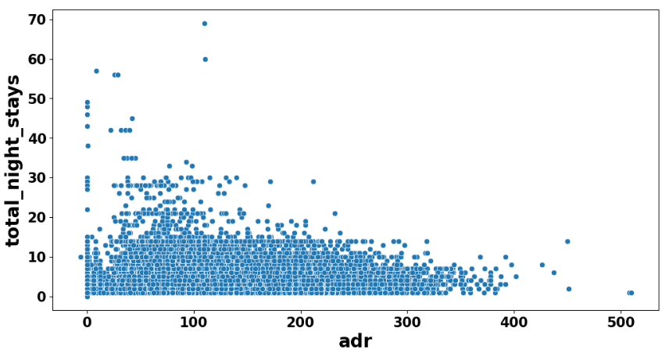
Total nights stays with ADR
If guest's stay days is getting decreased, ADR is getting high.
Maximum night stays count is in between 1 – 15 days.

Slide 21
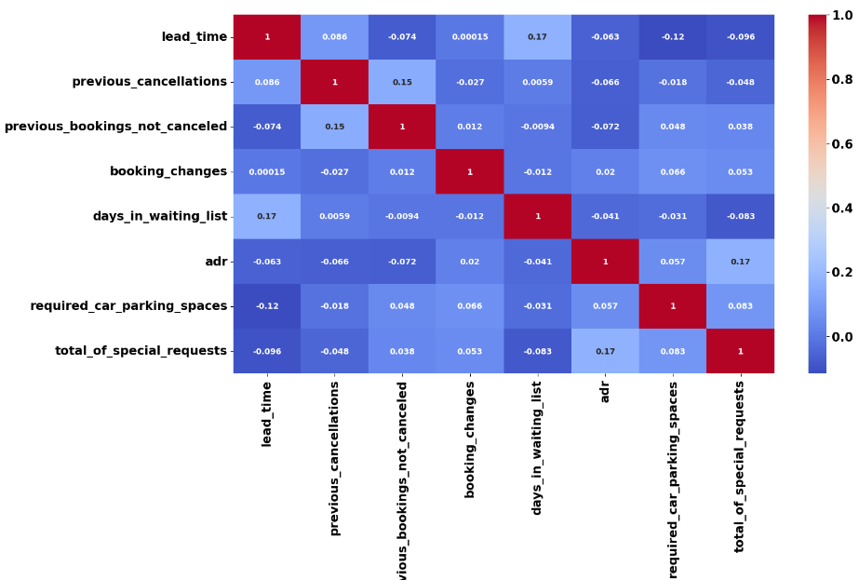
Correlation Heatmap
Correlation heatmaps are a type of plot that visualize the strength of relationships between numerical variables.

Slide 22
Conclusion
City Hotel seems to be more preferred among travellers and it also generates more revenue & profit.
Dataset contains booking data of 3 different years(2017,2016,2015), out of which, maximum hotel bookings took place in 2016 & 2015 witnessed the least number of hotel bookings.
Out of all months, 'August' witnessed highest number of hotel bookings whereas 'January' witnessed the least.
Most number of bookings are made from Portugal & Great Britain.
Its observed that 'City hotels' was more cancelled as compared to 'Resort hotels’.
As checked BB Meal type has high preference where as FB Meal Type has very low preference
We have found that, In 2015 highest ADR is in august month which is 122 and lowest ADR is in November month. For 2016 , highest ADR is in august month which is 148 and lowest ADR is in January month. For 2017 , highest ADR is in august month which is 168 and lowest ADR is in January month.

Slide 23
We found that if guest's stay days is getting decreased, ADR is getting high.
We have found that, almost 80000 customers dont want parking slot for car and as checked only 2 customers wants 8 parking slots. So we can consider 1 parking slot for each customer is fine.
Most of the hotels have 0 to 1 car parking space.
Among the top 10 countries with respect to number of bookings, most of them are European countries which belongs to the list of which Portugal stands first with 48.5k bookings.
Its observed that average ADR is incrementing every year from 2015 to 2017, which clearly states that hotel business is scaling up every year.
Given that we do not have repeated guests, we should target our advertisement on guests to increase returning guests.
Highest correlation value between axis is 17% positive which is in between adr and special requests so they are directly correspondent to each other.

Slide 24
References
https://seaborn.pydata.org/
https://pandas.pydata.org/
https://matplotlib.org/
Geek for geeks
Almabetter Study Materials

Slide 25
Thank You

